Slide 1
أكـــــاديميــــة طــــويـــق
Scalable Data Science

Slide 2
cuML: open-source GPU-accelerated machine learning library
By: Dr. Afshan Hashmi

Slide 3
Course Objectives:
Understand GPU-Accelerated Machine Learning – Learn how to leverage RAPIDS cuML for high-performance machine learning on large datasets, comparing it with traditional CPU-based approaches.
Implement Efficient ML Models – Develop and optimize machine learning models using cuML, including regression, classification, and clustering, to achieve faster training and inference times.
Apply cuML to Real-World Problems – Gain hands-on experience in applying GPU-accelerated ML techniques to practical use cases such as financial modeling, image recognition, and natural language processing.

Slide 4
Introduction to cuML(RAPIDS Machine Learning Library)
What is cuML?
cuML is an open-source GPU-accelerated machine learning library developed by NVIDIA as part of the RAPIDS AI framework. It provides highly optimized implementations of common machine learning algorithms using CUDA.
Why Use cuML?
Faster Computation: Leverages GPUs for parallel execution, significantly reducing training time.
Compatible with scikit-learn: Provides a similar API, making it easy to transition from CPU-based models.
Seamless Integration: Works well with cuDF (GPU-accelerated pandas) and other RAPIDS libraries.
cuML
Rapids Machine Learning Library

Slide 5
cuML-Supported Algorithms
cuML provides GPU-accelerated implementations of various machine learning algorithms, including:
Linear Models: Linear Regression, Ridge Regression, Lasso Regression
Clustering: K-Means, DBSCAN
Dimensionality Reduction: PCA, t-SNE, Truncated SVD
Tree-based Models: Random Forest, Decision Trees
Other Models: Nearest Neighbors, Support Vector Machines, Gaussian Mixture Models

Slide 6




Real-World Applications of cuML
Finance: Risk modeling, fraud detection, stock price prediction
Healthcare: Genomic analysis, patient diagnosis predictions
Retail: Customer segmentation, demand forecasting
Cybersecurity: Anomaly detection in network traffic
This Photo by Unknown Author is licensed under CC BY-SA-NC

Slide 7
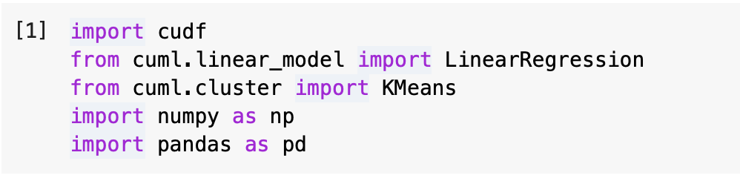
Importing cuML and Dependencies
cudf: A GPU-accelerated DataFrame library similar to pandas, optimized for NVIDIA GPUs.
cuml.linear_model.LinearRegression: GPU-accelerated linear regression model.
cuml.cluster.KMeans: GPU-accelerated K-Means clustering algorithm.
numpy and pandas: Used for handling arrays and data processing before converting them into GPU-optimized structures.
This setup ensures that machine learning workflows leverage GPU acceleration instead of CPU-based operations.

Slide 8
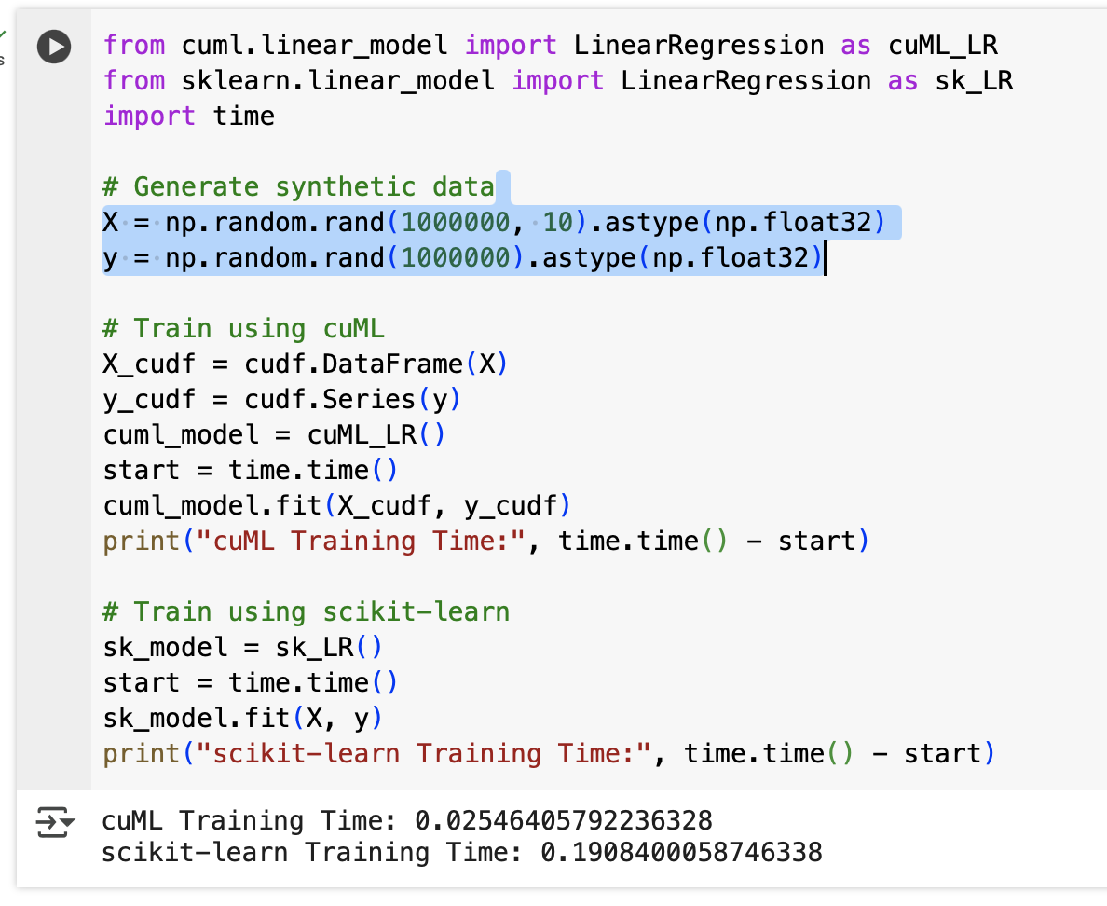
cuML vs. Scikit-Learn Speed Comparison
Uses cudf.DataFrame and cudf.Series to transfer data to the GPU.
Measures and prints the execution time for both implementations.
Demonstrates the potential speedup of cuML over scikit-learn for large datasets.

Slide 9
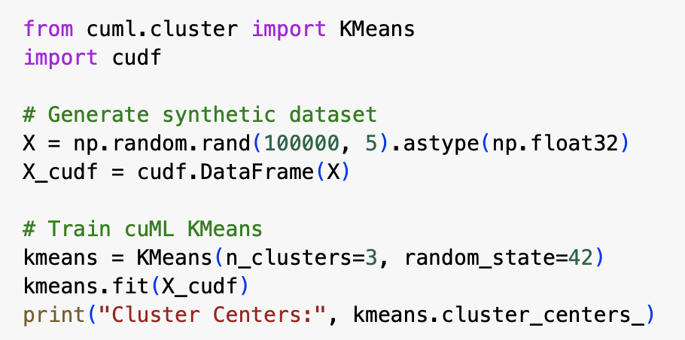
GPU-Accelerated K-Means Clustering
Implements GPU-based K-Means clustering, which is significantly faster than CPU-based implementations.
Uses cudf.DataFrame to store data in a GPU-compatible format.
Computes cluster centers efficiently using GPU-accelerated processing.
Helps in segmentation tasks, such as customer grouping in retail or anomaly detection.

Slide 10
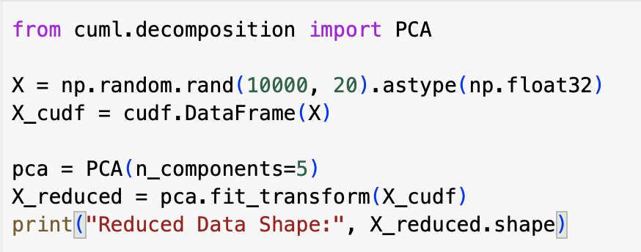
GPU-Accelerated Principal Component Analysis
Implements GPU-accelerated PCA, which reduces dimensionality faster than traditional PCA methods.
Uses cudf.DataFrame for efficient GPU memory handling
Helps in feature extraction and compression in large datasets.
Essential for preprocessing high-dimensional datasets in computer vision, bioinformatics, and NLP.

Slide 11
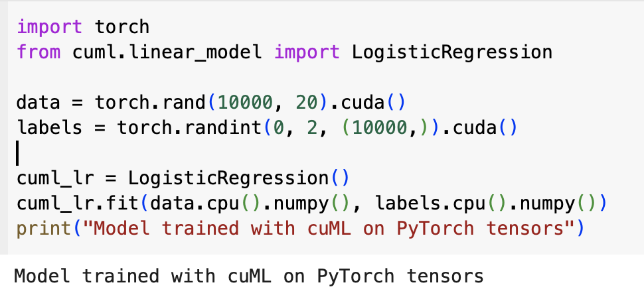
Integrating cuML with Deep Learning (TensorFlow/PyTorch)
Shows how cuML can work alongside deep learning frameworks like PyTorch.
Moves data to GPU using .cuda(), but transfers it to CPU (.cpu().numpy()) before using cuML (since cuML does not support PyTorch tensors directly).
Enables hybrid machine learning and deep learning workflows, useful in reinforcement learning, AI-powered security, and fraud detection.

Slide 12
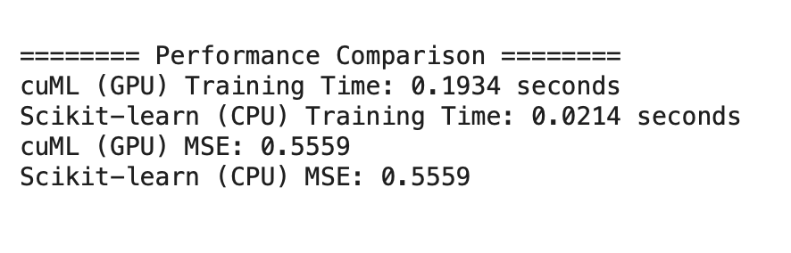
Project : Predicting House Prices using cuML
Steps:
Load the dataset (California housing dataset from sklearn).
Preprocess the data and move it to cuDF for GPU processing.
Train a Linear Regression model using cuML.
Compare performance with Scikit-learn (CPU-based).
Evaluate the model's performance (MSE & Training Time).
For Full code click here

Slide 13
Advantages and Limitations of cuML
Advantages:
Massively Parallel Computation: Ideal for large datasets.
Easy Transition from scikit-learn: Similar API.
Optimized for NVIDIA GPUs: Provides huge speedups.
Limitations:
Requires NVIDIA GPU: Not useful for CPU-only environments.
Memory Constraints: GPU memory is limited compared to CPU RAM.
Limited Algorithm Support: Some ML models are not yet implemented in cuML.

Slide 14
Comparison of cuML with Scikit-learn
Aspect | Scikit-learn | cuML
Hardware | CPU | GPU
Speed | Slower for large datasets | Faster due to GPU acceleration
Scalability | Limited by CPU memory | Handles larger datasets efficiently
Ease of Use | Beginner-friendly | Requires GPU knowledge
Algorithm Coverage | Extensive | Limited but growing

Slide 15

Practical Implementation
Click on the link below to go to Google COLAB
Click HERE

Slide 16

















الشراكات العالمية

Slide 17
شــــــكــــرًا لكــــــم
THANK YOU

